Slide 1

Parent’s RSE INFORMATION
2023-2024

Slide 2
Relationships and sex education

Slide 3
What is RSE?
    The place of RSE in the curriculum of a Catholic School
A Journey in Love
    An introduction to the programme
    Its structure and content

Slide 4
RSE is the life long learning about physical, moral and emotional development.
It is the understanding of the importance of marriage for family life, stable and loving relationships, respect, love and care.
It is also about the teaching of sex, sexuality and sexual health

Slide 5
A Journey in Love
The central message of the Christian faith is love. The central message of our rse teaching is love.
“My commandment is this: love one another, just as I have loved you”
John 15:12

Slide 6
A Journey in Love
Approved by the Diocese, the programme teaches that:
The journey begins at the moment of our conception God is at the heart of love
Puberty can be an extremely confusing time for children, our message will be that even in this confusion, God is there
The Sacrament of marriage publicly declares the commitment of each spouse to the other permanently in the acknowledgement that it is God-given

Slide 7
A Journey in Love
The programme is made up of 4 areas:
Physical
Social
Emotional
Intellectual
Each area is broken down into:
Activities
Pause & Reflect
Prayer

Slide 8
Reception
Children know and understand that God has made them unique and that although we are all different we are all special to him.
Examples of Reception activities:
A graph of eye colours
Why was I given my name?
Who are my friends?
I grew for 9 months in my mummy’s tummy, Jesus grew for 9 months in Mary’s womb

Slide 9
Year 1
Children know and understand that they are growing and developing as members of their own family and God’s family.
Examples of Year 1 activities:
Draw a picture of my family
How old was I when I learned to crawl, speak etc.
How can I help at home?
We are members of God’s family

Slide 10
Year 2
Children know and understand that they are growing and developing in a God-given community.
Examples of Year 2 activities:
What is community?
Explore school as a community
How can we contribute to the community?
As children of God, how should we help each other?

Slide 11
Year 3
Children know and understand the virtues essential to friendship e.g. loyalty, responsibility and experience the importance both of forgiving and being forgiven and of celebrating God’s forgiveness.
Examples of Year 3 activities:
Who cares for me at home, school, parish, community?
How do you keep safe?
How do you take care of others?
How do you feel if a friend is not there for you or you are not there for them?
How can I forgive and include others as Jesus did?

Slide 12
Year 4
Children know and understand that they are all different and celebrate these differences as they appreciate that God’s love accepts us as we are and as we change.
Examples of Year 4 activities:
Recognise all pupils grow and develop at a different rate
Name male and female body parts
Identify the development of the baby in the womb
How do I appreciate my own and others gifts, talents, achievements and all that makes us unique
St Paul’s teaching on love

Slide 13
Year 5
Children know and become aware of the physical and emotional changes that accompany puberty- sensitivity, mood swings, anger, boredom, etc. and grow further in their understanding of God’s presence in their daily lives.
Examples of Year 5 activities:
Identify and celebrate the ways I have changed since birth
Discuss the external and internal changes which happen to boys and girls in puberty
Recognise behaviour changes as we grow up
Children share their understanding of change through poetry, prayer, art etc.

Slide 14
Year 6
Children develop, in an appropriate way for their age, an understanding of sexuality and grow further in their appreciation of their dignity and worth as children of God.
Examples of Year 6 activities:
Explain how human life is conceived
Male and female reproductive organs
Sexual intercourse between husband and wife
How a child grows within the mother’s womb
How we often use the word love too casually
Understand that God causes new life to begin through the love that parents have for each other

Slide 15
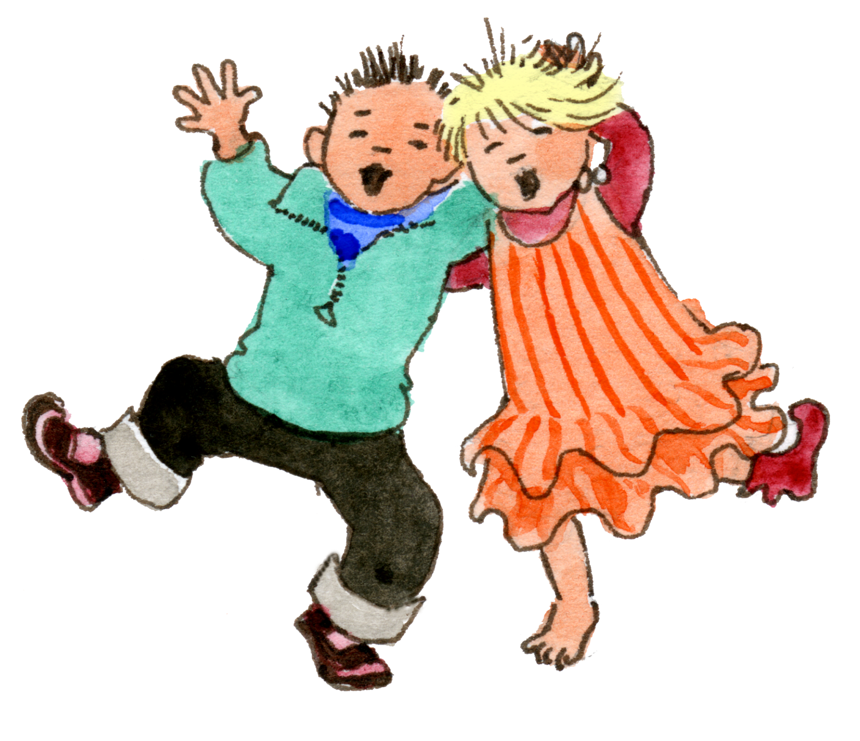
Reception
God loves each of us in
our uniqueness
1 A Journey in Love - Reception

Slide 16
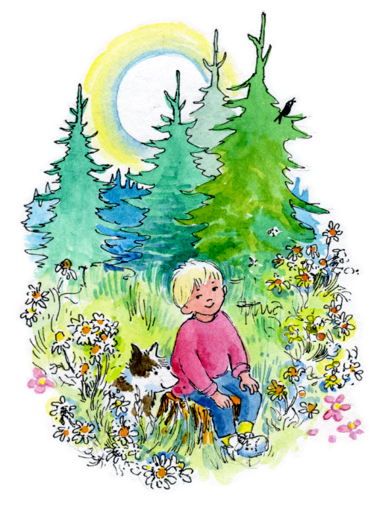
Objective
Know that there
is no one more
special than me.
Know that God
made me and
loves me as I am.
2 A Journey in Love - Reception

Slide 17
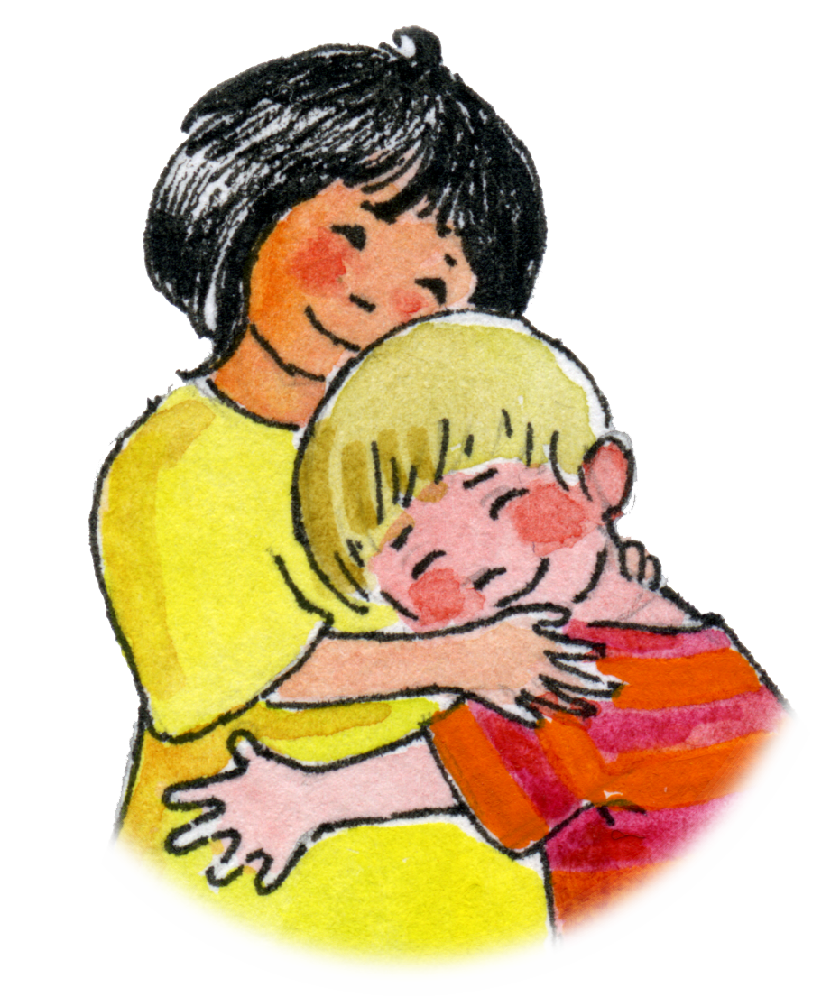
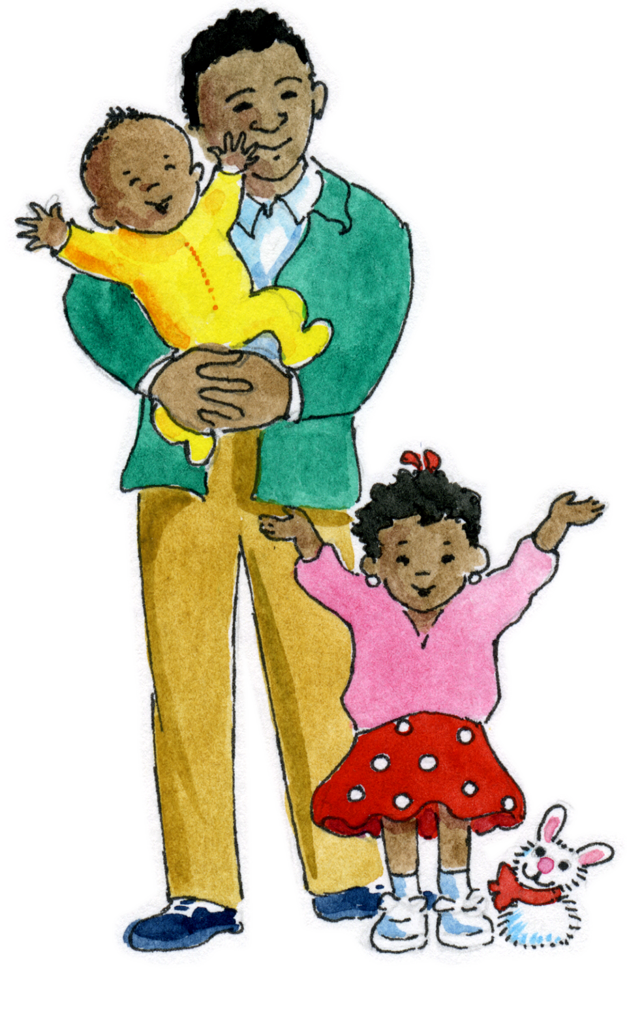
Keywords
God Unique Special Eyes | Hair Boy/Girl Hands Fingers Name | Family Love Womb Describe
3 A Journey in Love - Reception

Slide 18
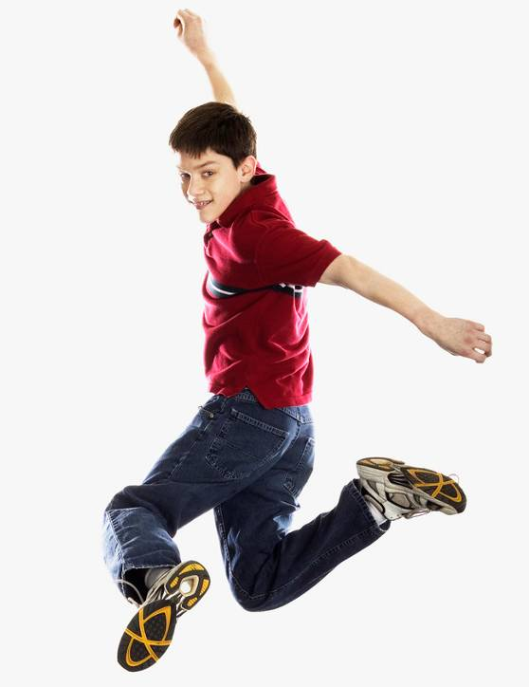
Year Four
God loves us in our differences
1 A Journey in Love - Year 4

Slide 19
Objectives
Know that God has made us
different from one another.
Know that God loves us
in our differences.
2 A Journey in Love - Year 4

Slide 20
Keywords
God,
Gifts,
Talents,
Difference,
Development,
Change,
Male and female
body parts,
Conflict,
Appreciate,
Celebrate,
Achievement,
Sensitivity,
Respect.
3 A Journey in Love - Year 4

Slide 21
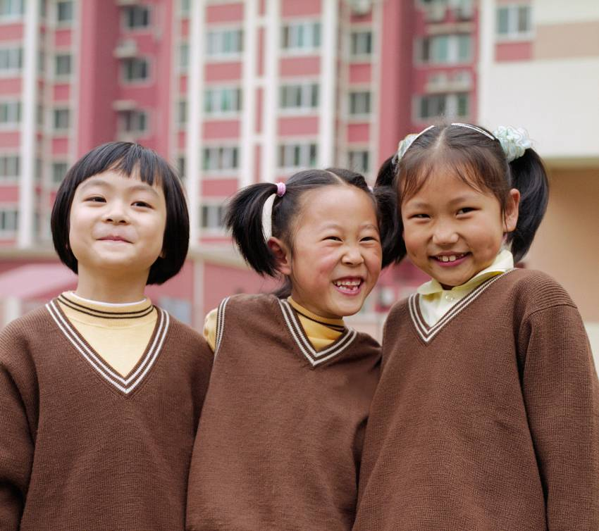
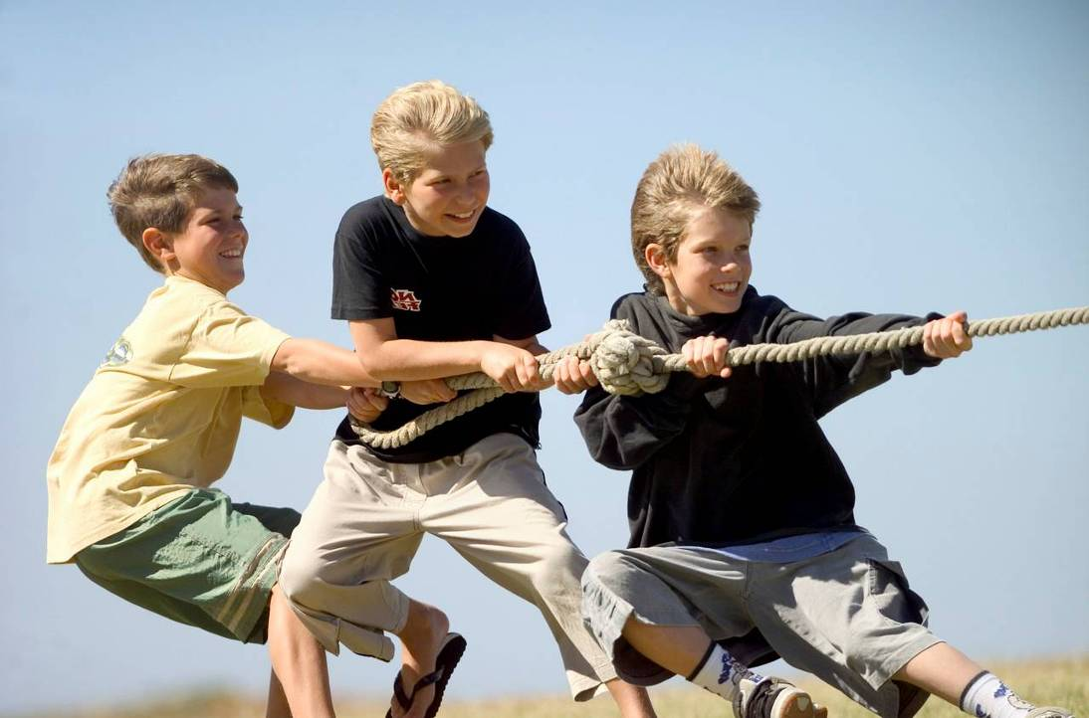
PHYSICAL
We grow and develop at different rates.
We are different shapes and sizes.
4 A Journey in Love - Year 4

Slide 22
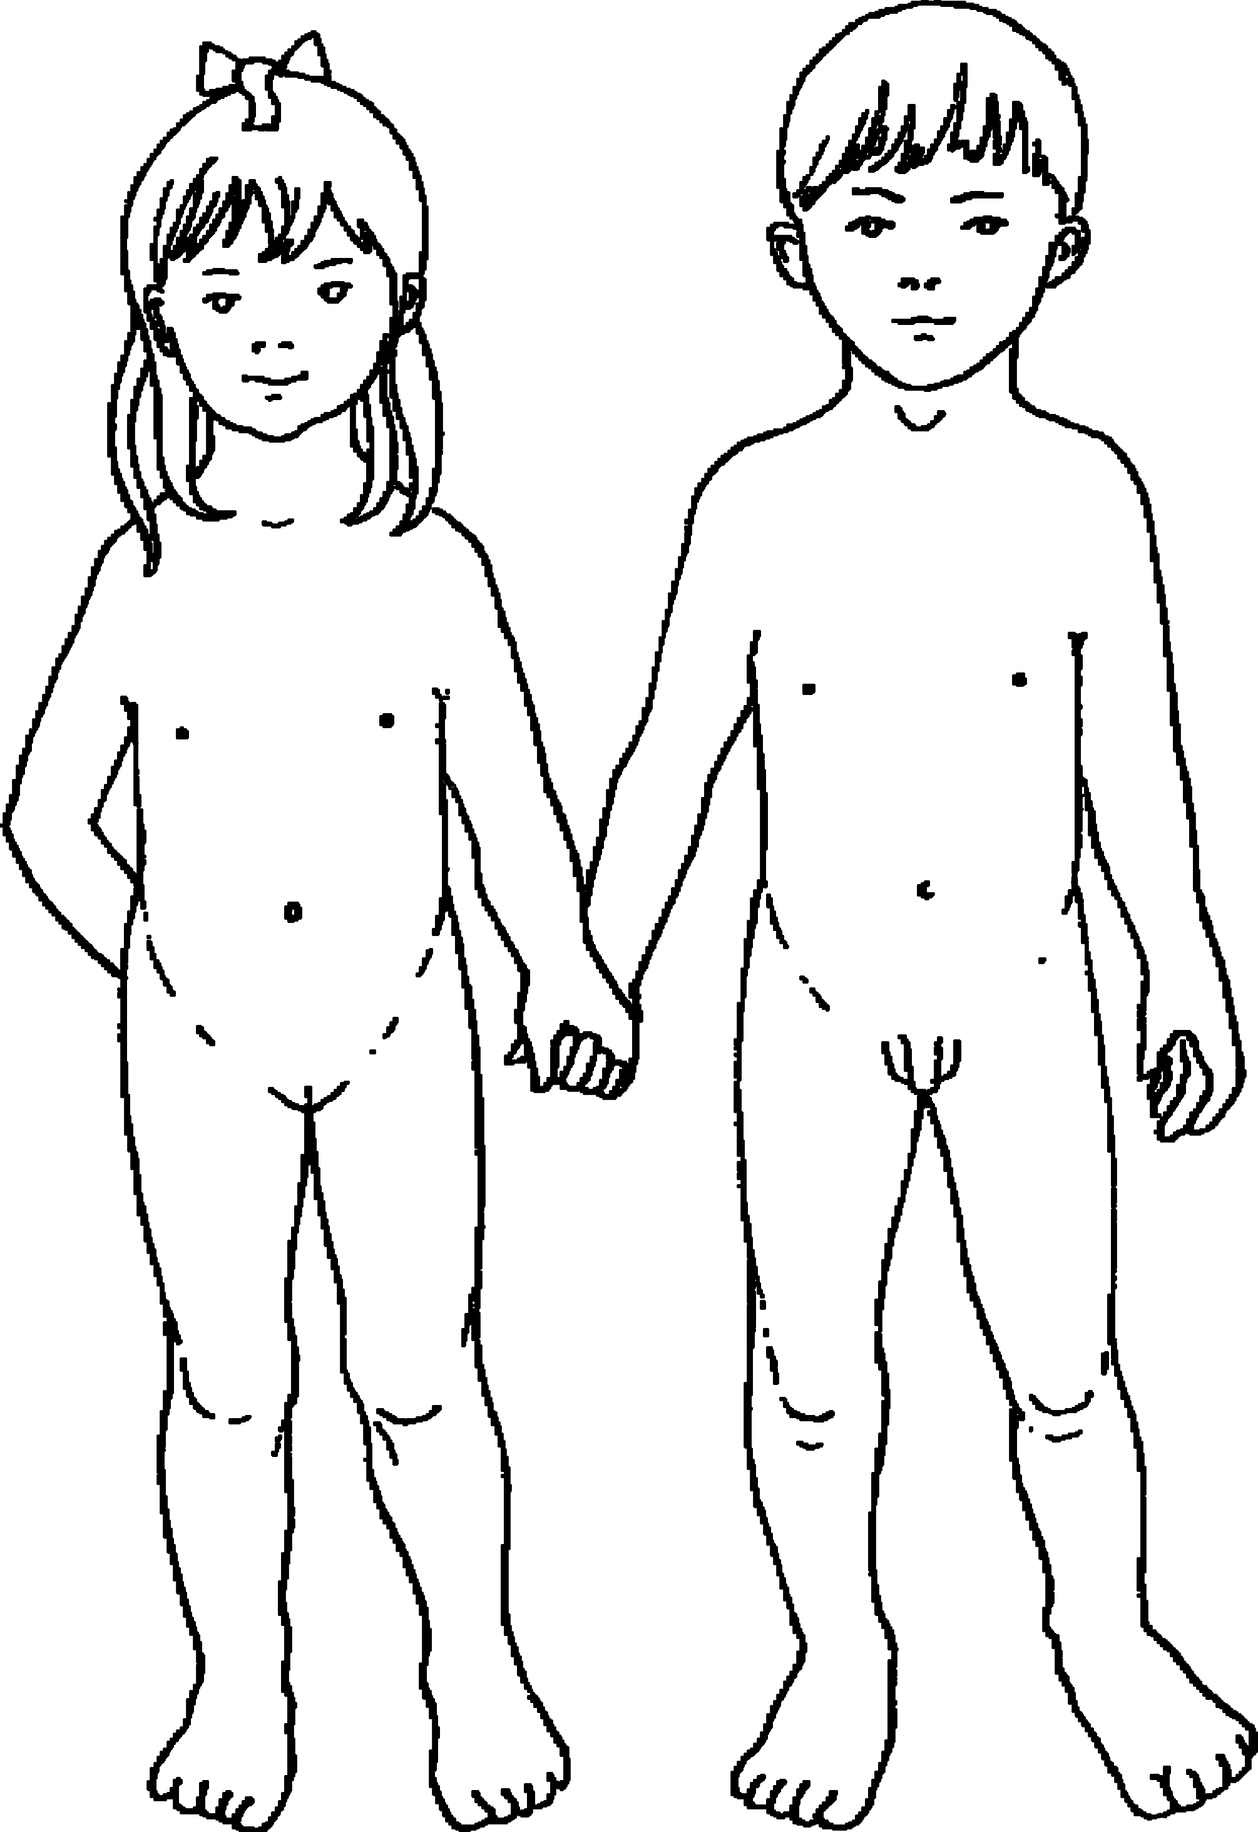
Boys and girls are different
What are the
differences?
5 A Journey in Love - Year 4

Slide 23
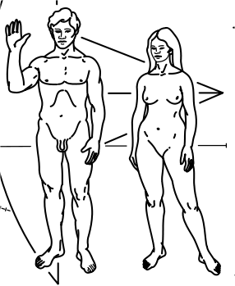
Men and women are different
What are the
differences?
6 A Journey in Love - Year 4

Slide 24
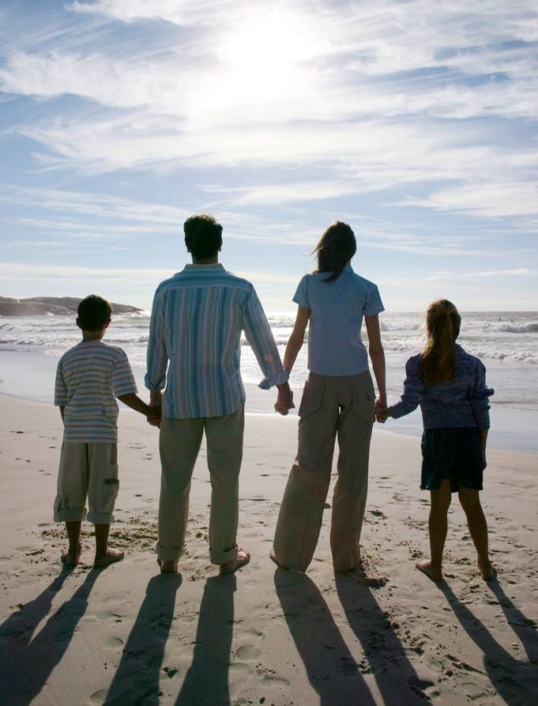
Man, woman, boy or girl...
We are each unique…
...we accept ourselves
and each other.
7 A Journey in Love - Year 4

Slide 25
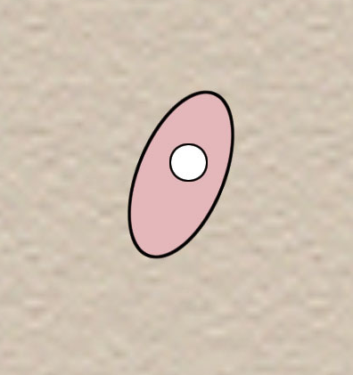
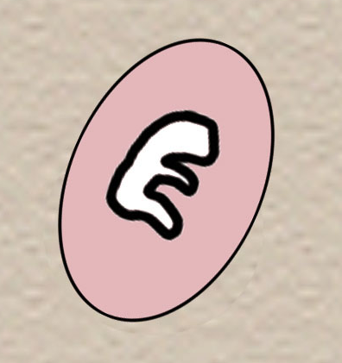
Development of a baby in the womb
Conception
4 weeks
The baby is just large enough to see.
He/she is about half the size of a full stop.
His/her heart is formed and he/she has small leg and arm buds.
8 A Journey in Love - Year 4

Slide 26
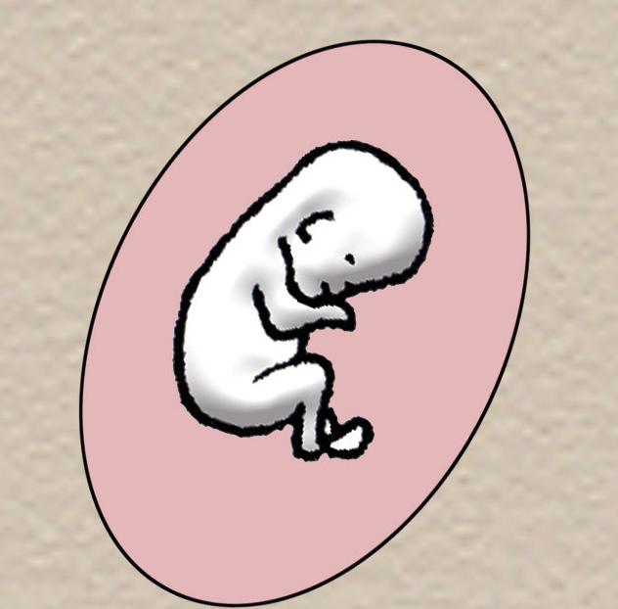
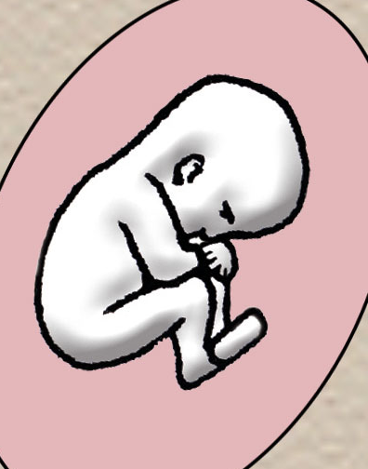
8 weeks
The baby’s eyes
and ears
are developing
and legs show
knees and
ankles;
toes are joined
together.
12 weeks
All the
important
parts
are formed
and nails
begin
to grow.
9 A Journey in Love - Year 4

Slide 27
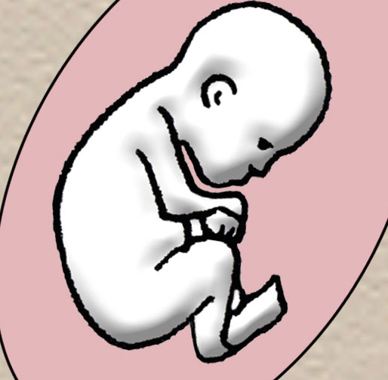
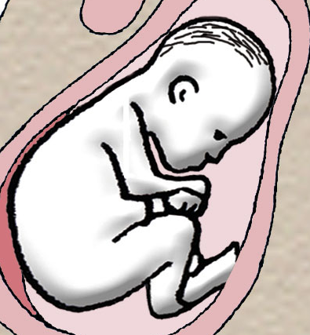
16 weeks
Some bones are hardening.
The mother can feel movements
and the baby can suck his/her
thumb.
20 weeks
The baby is now 25-27 cm long.
His/her fingernails and toenails
are fully grown.
10 A Journey in Love - Year 4

Slide 28
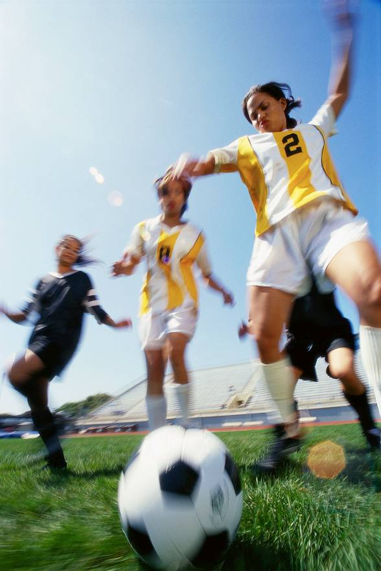
Year Five
God loves me in
my changing
and development
1 A Journey in Love - Year 5

Slide 29
Objectives
* Know that as we grow we will become
different in our…
…bodies
…feelings
…love of God
2 A Journey in Love - Year 5

Slide 30
Keywords
External
Internal
Change
Develop
Ovulation
God
Sensitivity
Puberty
Presence
Celebrate
3 A Journey in Love - Year 5

Slide 31
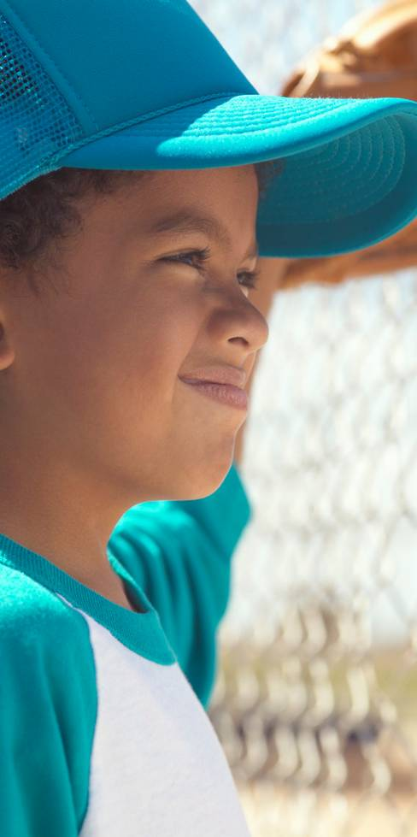
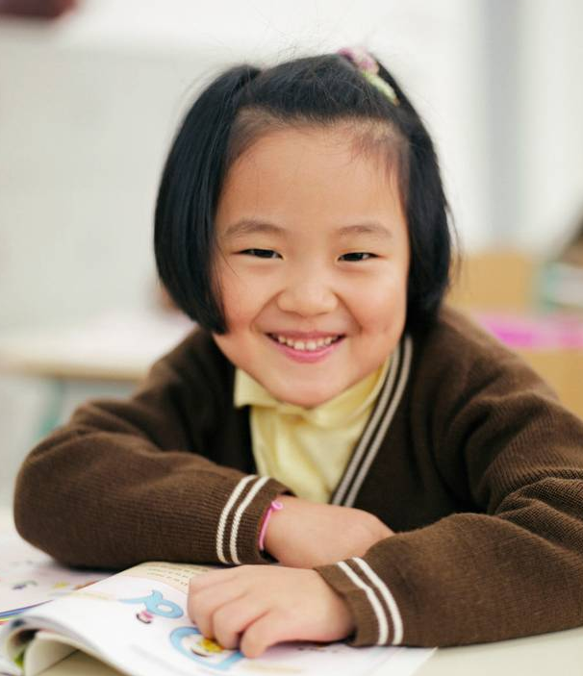
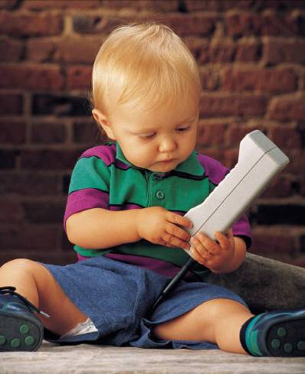
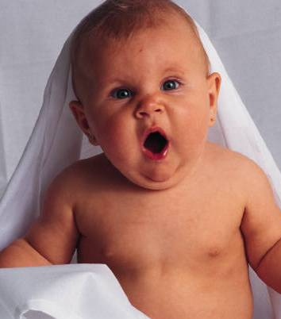
Physical and Intellectual
We have changed in many ways since
we were born.
We have grown…
4 A Journey in Love - Year 5

Slide 32
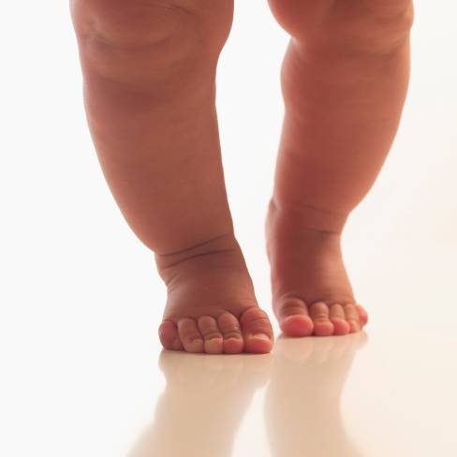
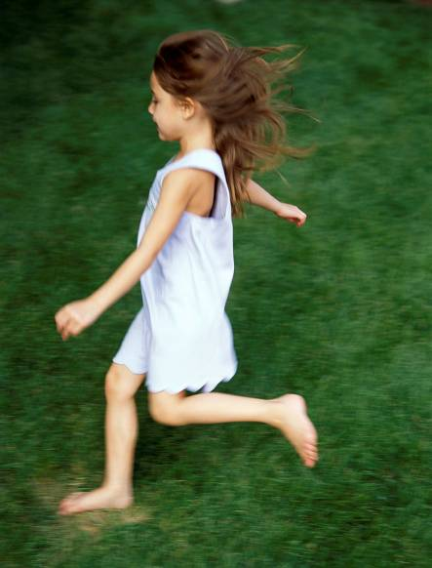
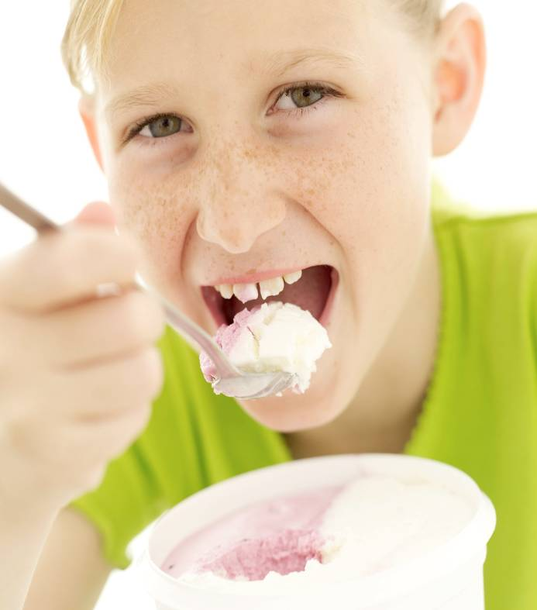
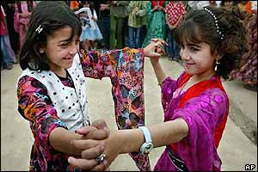
We can do more…
Run
Walk
Feed ourselves
Dance
5 A Journey in Love - Year 5

Slide 33

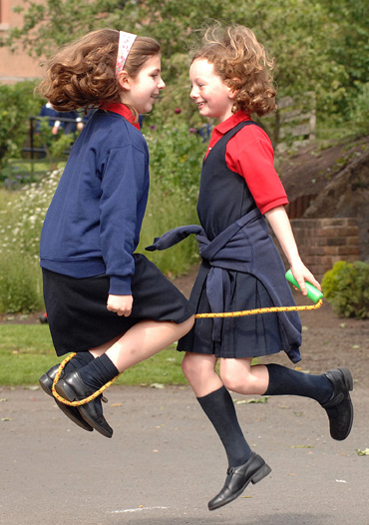
Read and
write
Play
Make friends
6 A Journey in Love - Year 5

Slide 34
We will change more before we are grown
boy…
…to man
7 A Journey in Love - Year 5

Slide 35
Physical changes in boys
Testosterone in the bloodstream triggers changes
Muscles and bones develop
Voice deepens
Some boys get uneven breast development in early puberty
Waist thickens
Limbs lengthen in proportion to body
Shoulders broaden
Wet dreams and erections
8 A Journey in Love - Year 5

Slide 36
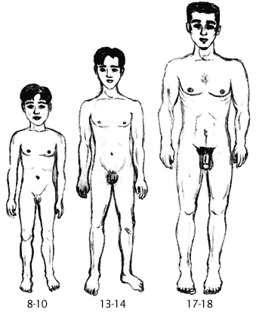
Physical changes in boys continued
Penis and scrotum enlarge
Production of sperm and discharge
of seminal fluid during ejaculation
Adam’s apple enlarges
Hair can grow on face, chest
and back as well as underarms
and pubic area
9 A Journey in Love - Year 5

Slide 37
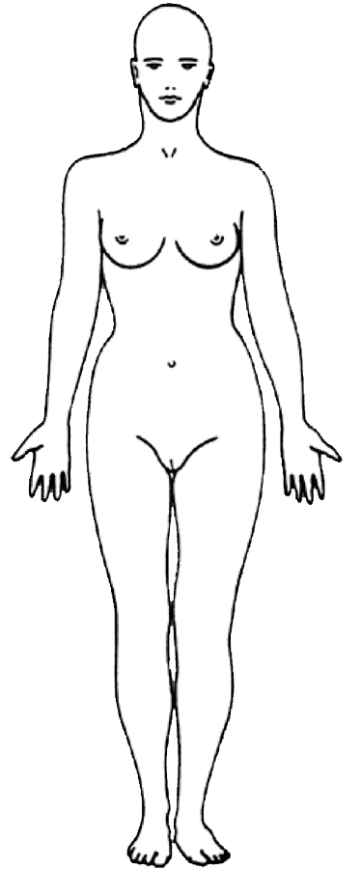
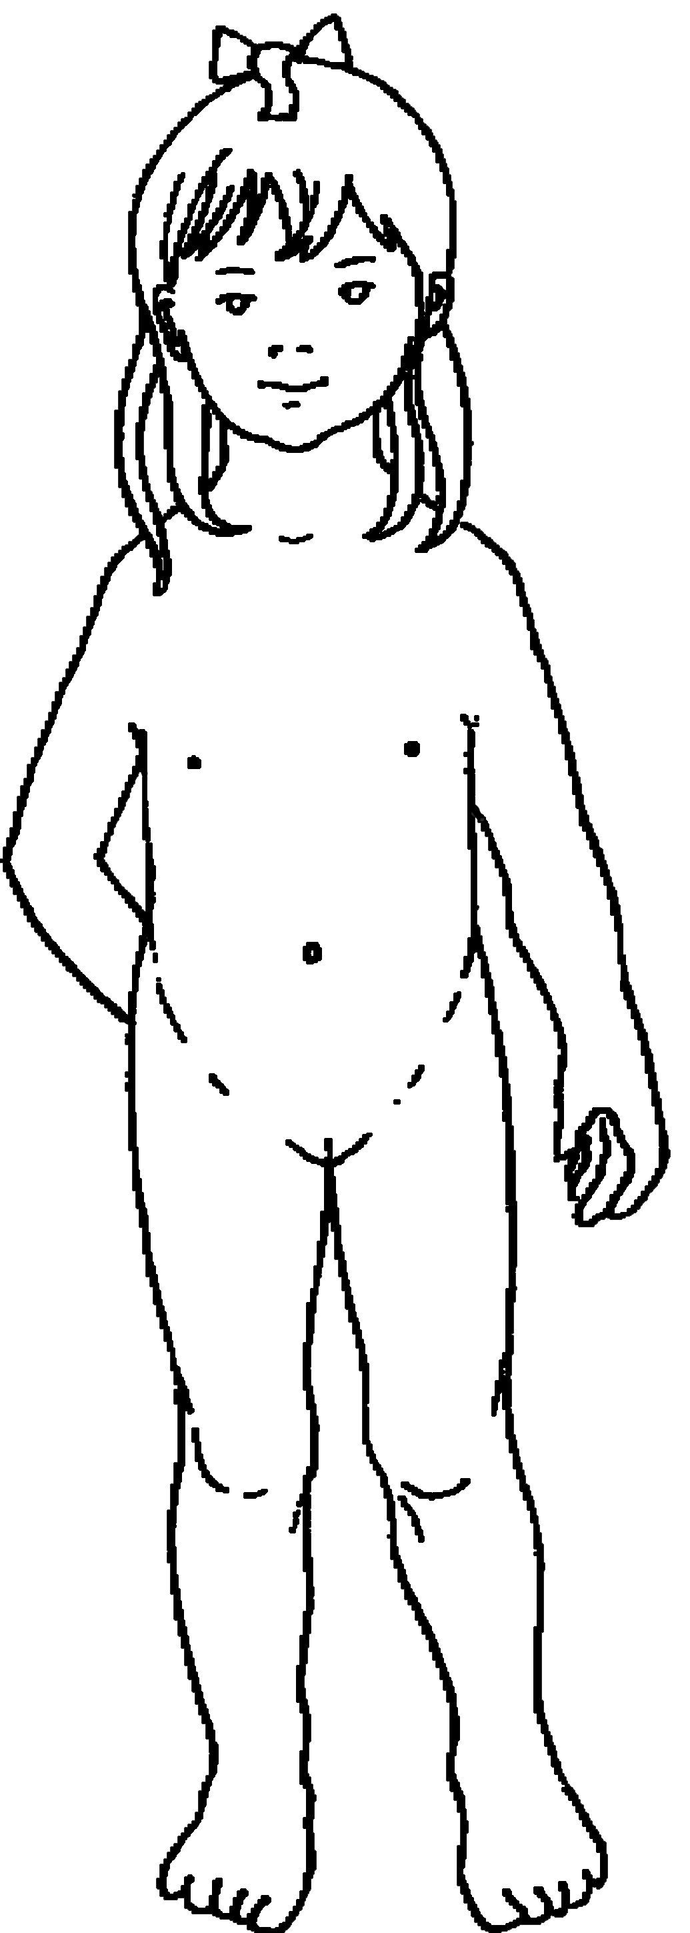
girl…
…to woman
10 A Journey in Love - Year 5

Slide 38
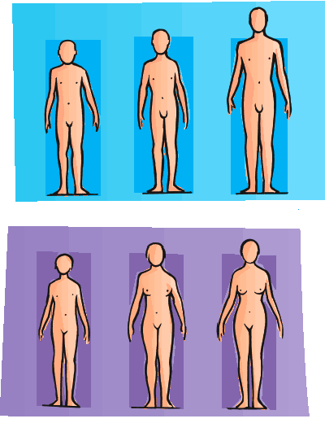
Physical changes in girls
Breasts develop: they come in all shapes and sizes
Hips broaden and waist slims
Ovaries produce oestrogen
Hormonal activity
Menstruation begins (about 12 months
after breasts begin to develop)
Uterus enlarges
Usually start to grow hair on
underarm, pubic area and legs
Vaginal lining thickens
11 A Journey in Love - Year 5

Slide 39
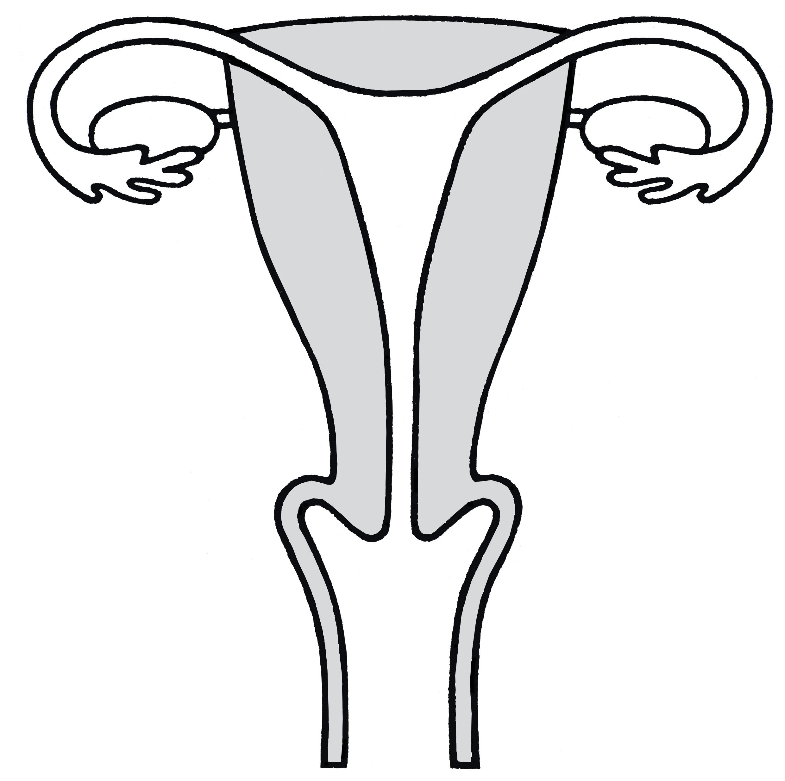
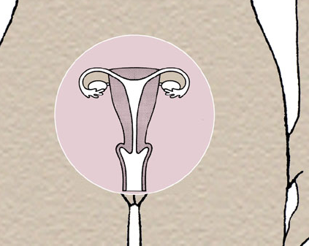
Menstruation
The menstrual cycle is to
prepare the female body for
reproduction
Inside a woman’s body:
d
c
a. Vagina
b. Cervix
c. Womb (uterus)
d. Fallopian tube
e. Ovary
e
b
a
12 A Journey in Love - Year 5

Slide 40
There are 2 important stages:
1. Menstruation
The menstrual cycle is controlled by hormones
released from the pituitary gland.
Most menstrual cycles last for about 28 days.
The first day of the period marks the start
of the cycle and is counted as day 1.
If the uterus does not receive a fertilised ovum,
the lining of the uterus breaks down and is
shed over the next few days.
This is called menstruation.
The lining of the uterus begins to thicken and
an ovum begins to develop.
d
c
e
b
a
a. Vagina
b. Cervix
c. Womb (uterus)
d. Fallopian tube
e. Ovary
13 A Journey in Love - Year 5

Slide 41
2. Ovulation
On about the 14th day of the cycle an ovum is released into the fallopian tube.
This is called ovulation.
The ovum travels towards the uterus.
The lining of the uterus continues to thicken
and gets full of blood in case a fertilised
ovum arrives.
If the ovum is not fertilised it will dissolve and
a period will occur.
Then the cycle starts again…
d
c
e
b
a
a. Vagina
b. Cervix
c. Womb (uterus)
d. Fallopian tube
e. Ovary
14 A Journey in Love - Year 5

Slide 42
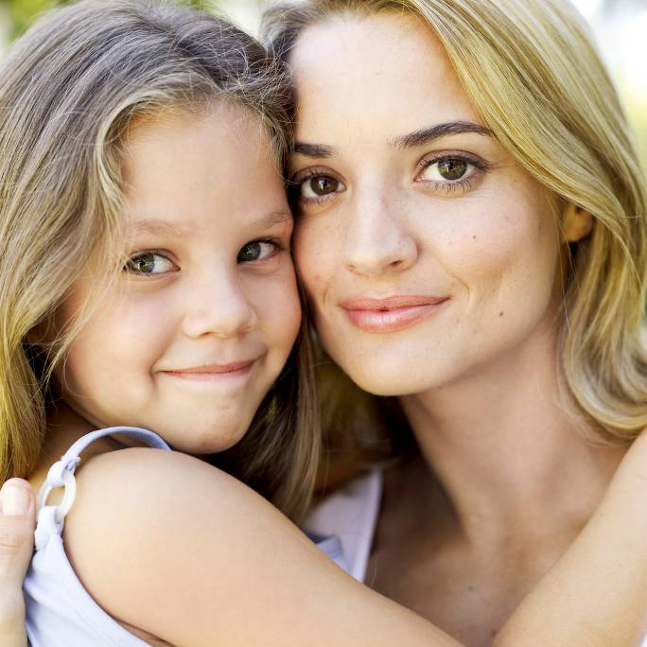
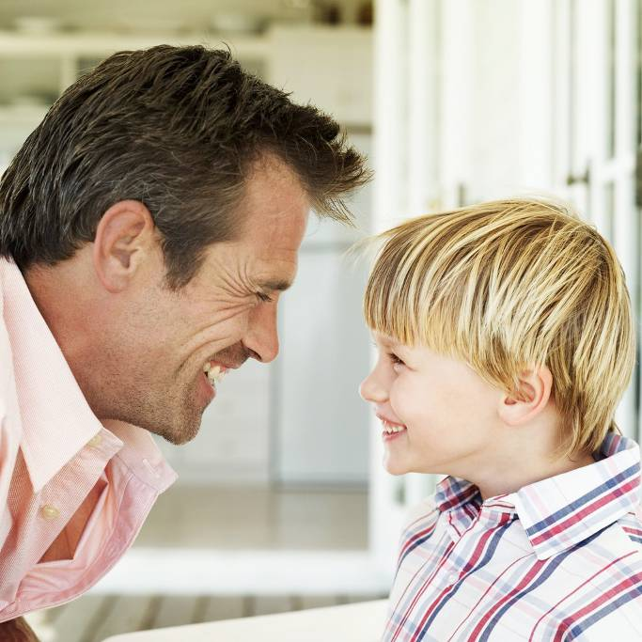
These changes are a natural part of growing up
Physical changes from child to adult mean they bring the ability and potential to become a mother or father.
15 A Journey in Love - Year 5

Slide 43
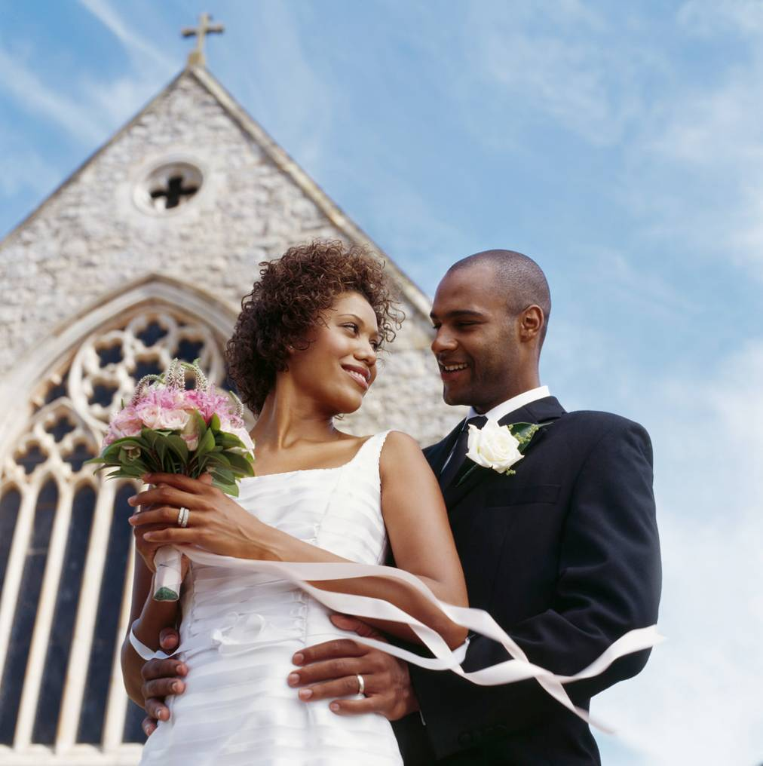
Year Six
The wonder of
God’s love in
creating new life
1 A Journey in Love - Year 6

Slide 44
Objectives
Know that we are made to love
and to be loved.
Learn the proper ways in which we
show our love for one another and
for God.
2 A Journey in Love - Year 6

Slide 45
Keywords
God
Christian
Appropriate
Dignity
Sexuality
Intercourse
Fiancé
Fallopian
Conceive
Relationship
Uterus
Cervix
Marriage
3 A Journey in Love - Year 6

Slide 46
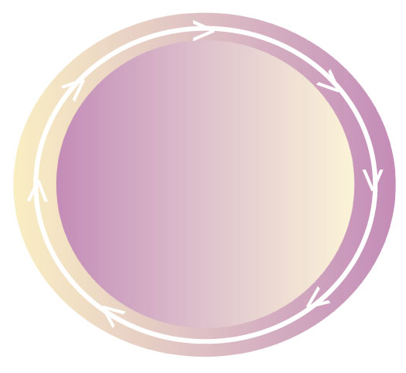
The circle of love and life
Marriage
‘Make love’
Choosing
a fiancé(e)
New life
and love
LOVE CIRCLE
First signs
of romantic
love
Self-centred
love
Give and take
of love
‘click’
4 A Journey in Love - Year 6

Slide 47
Considerations to make
Whole class teaching – reception to Year 5
Children to be taught in single age classes
year 6 to be taught ALSO in SINGLE SEX groups TO ALLOW OPPORTUNITY FOR QUESTIONS TO BE ANSWERED BY GENDER APPROPRIATE TEACHER.
AS A CATHOLIC SCHOOL, WE DO NOT TEACH ABOUT CONTRACEPTION. IT IS THE RESPONSIBILITY OF PARENTS TO SHARE THIS INFORMATION AS THEY SEE APPROPRIATE.

